Slide 1

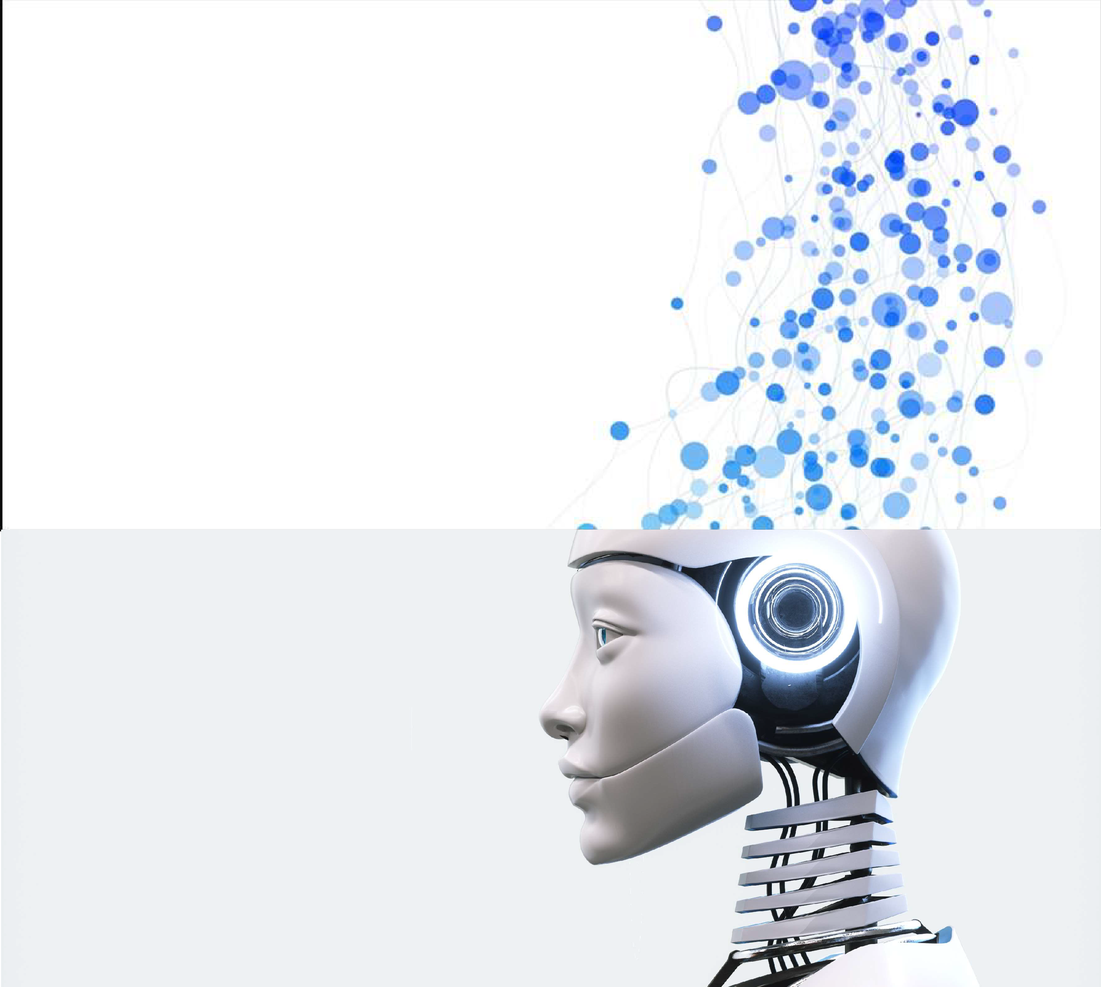
Machine Learning Foundations
An Introduction to your AI Journey
Presented by : ilyas tammouch
1
Notes:
ilyas.tammouch@uit.ac.mailyas.tammouch@uit.ac.ma

Slide 2
Provide comprehensive understanding of the core principles of Machine Learning with hands-on training on applying machine learning to solve real-world problems.
Course Objective
A learner who completes this course should be able to define a machine learning problem, understand the solution path, and display the ability to carry out the end-to-end process of building a machine learning application.
2

Slide 3
Machine Learning Career Prospectus
Data Scientist
AI Scientist
ML/AI Engineer
Data Engineer
Data Analyst
AI/ML Developer
IoT Developer
Solutions Architect
Freelancer
…
3

Slide 4

Introduction to Machine Learning
History and core concepts of ML to navigate the future lessons.
Applications of ML.
9

Slide 5


Example: Identify Objects
What facts you consider to identify these object?
Pineapple
Apple
10

Slide 6
Memorize Facts
Declarative Knowledge
Limited by memory and time to observe
How we Learn ?
Infer (deduce new information from previously known facts)
Imperative Knowledge
Limited by accuracy of predictions and drifts (present is not behaving the same way as past)
11

Slide 7



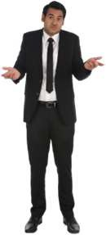








What is this ?
Help me
Apple
What is this ?
Apple
12

Slide 8







Select Apples
SGeoloecdtjAobpp!les
13

Slide 9
















Select Apples
14

Slide 10




What is this ?
May be apple… ?
Help me
Apple
What is this ?
Apple
15

Slide 11
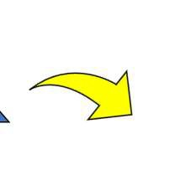
What is Machine Learning ?
Learn from Data
Machine |  | Learning
Data
Algorithms
“Teacher”
Model
17

Slide 12

Machine learning model
“Machine learning models are built on mathematical algorithms and are trained using data and human expertise to help us accurately predict outcomes based on input data such as images, text, or language.”
https://developer.nvidia.com/ai-models
18

Slide 13
















Computer Program vs. Machine Learning
Traditional Programing
Programmer
Algorithm (Computer Code)
Algorithm (Computer Code)
User Data
Result/ Output
Rules Logic Equations
Building Solution
Usage
Machine Learning
Data Scientist
Training
Training Data
Infer
ML Model
User Data
ML Model
Result/ Output (Prediction)
ML Algorithm
Known Result/ Output
Usage
Building Solution
19

Slide 14
“The field of study that gives computers the ability to learn without being explicitly programmed.“
~ Arthur Samuel (1959)
What is Machine Learning?
Author of first self-learning program to learn how to play checkers by learning from experience (past movements and results)
© 2021 Sumudu Tennakoon
20

Slide 15






Machine Learning/Deep Learning/AI
Artificial Intelligence (AI)
Language Processing
Machine Learning (ML)
Speech
Vision
Classical ML
Deep Learning
Motion
Decision Making
Data Science
Reasoning
23

Slide 16




Input and Output ?
Color
red
yellow
Apple (A)
Input
(Features/Attributes)
Output
Weight
50 g
200 g
Diameter
10 cm
20 cm
Pineapple (P)
31

Slide 17



𝐼𝑛𝑑𝑒𝑝𝑒𝑛𝑑𝑒𝑛𝑡 𝑉𝑎𝑟𝑖𝑎𝑏𝑙𝑒𝑠
𝐷𝑒𝑝𝑒𝑛𝑑𝑒𝑛𝑡 𝑉𝑎𝑟𝑖𝑎𝑏𝑙𝑒
𝑋 = [𝑥1, 𝑥2, 𝑥3, … . ]
𝑦
{𝐶𝑜𝑙𝑜𝑟, 𝐷𝑖𝑎𝑚𝑒𝑡𝑒𝑟, 𝑊𝑒𝑖𝑔ℎ𝑡}
{𝐴𝑝𝑝𝑙𝑒, 𝑃𝑖𝑛𝑒𝑎𝑝𝑝𝑙𝑒}
32

Slide 18
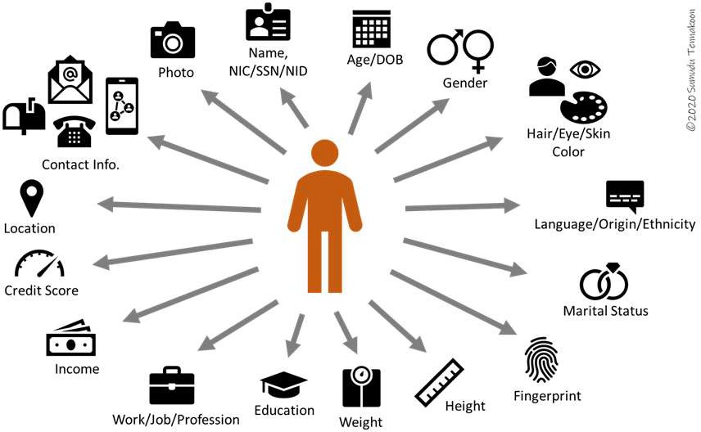
Features/Attributes
https://pu©b2.t0o2w1 aSrudmsuadi.unTeetn/ndaaktoao-nscience-for-everyone-getting-to-know-your-data-part-1-bb8b6d7782b1
33

Slide 19
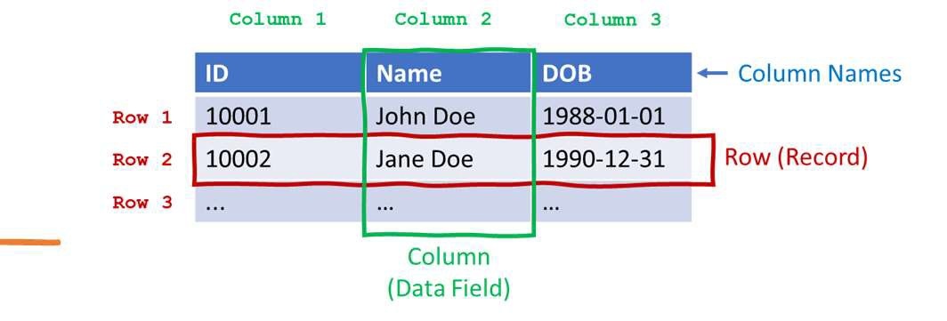
Tabular Data
https://pu©b2.t0o2w1 aSrudmsuadi.unTeetn/ndaaktoao-nscience-for-everyone-getting-to-know-your-data-part-1-bb8b6d7782b1
34

Slide 20
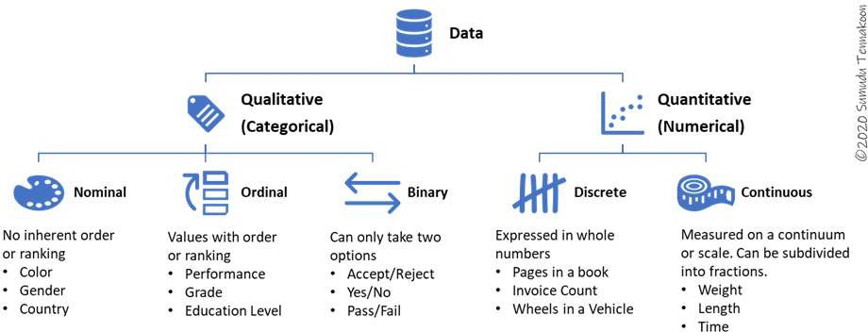
Understanding Data
35

Slide 21
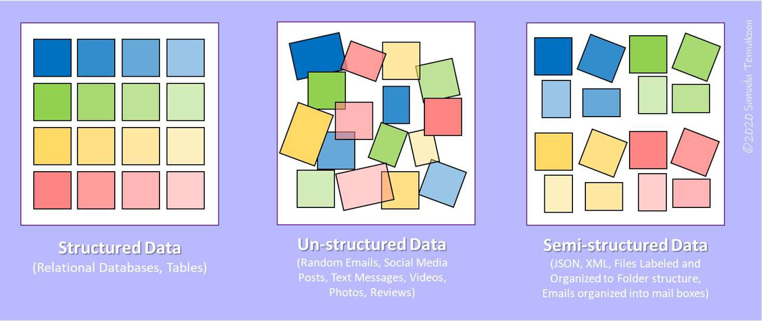
36

Slide 22









Machine Learning Approaches
Supervised
Unsupervised Reinforcement learning
38

Slide 23





Prediction
Low = 1
Medium = 2
High = 3
Cloud Cover
Temperature 25 C
Rain (Y/N)
Humidity 70 % (RH)
𝑦 = 𝑓 𝑋 ?
46

Slide 24
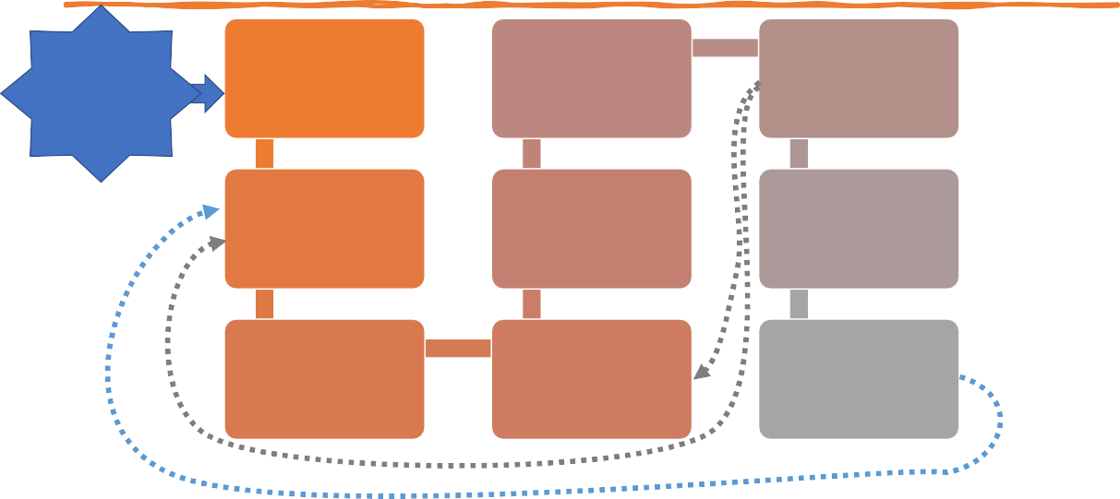
Steps of Building ML Model
Evaluate Model Performance
Understand the Problem and the Requirements
Acquire Data
Tune Model
Deploy Model into Application
Analyze and Prepare Data
Predict on Test Sample
Design ML Solution
Train Model
Monitor
Feedback and Additional Data (After deployment)
48

Slide 25

Supervised Learning
Introduction
Machine Learning

Slide 26
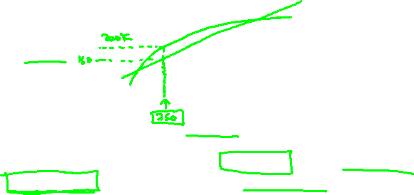
Housing price prediction.
Price ($)
in 1000’s
Size in feet²
Supervised Learning
“right answers” given
Regression: Predict continuous valued output (price)

Slide 27
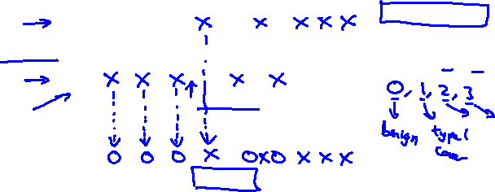
Breast cancer (malignant, benign)
Classification
Discrete valued output (0 or 1)
1(Y)
Malignant?
0(N)
Tumor Size
Tumor Size

Slide 28
You’re running a company, and you want to develop learning algorithms to address each of two problems.
Problem 1: You have a large inventory of identical items. You want to predict how many of these items will sell over the next 3 months.
Problem 2: You’d like software to examine individual customer accounts, and for each account decide if it has been hacked/compromised.
Should you treat these as classification or as regression problems?
Treat both as classification problems.
Treat problem 1 as a classification problem, problem 2 as a regression problem.
Treat problem 1 as a regression problem, problem 2 as a classification problem.
Treat both as regression problems.

Slide 29
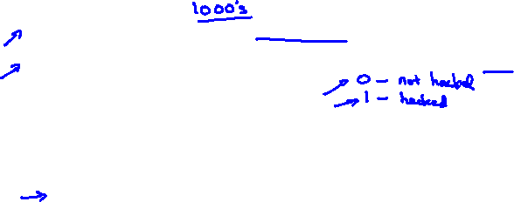
You’re running a company, and you want to develop learning algorithms to address each of two problems.
Problem 1: You have a large inventory of identical items. You want to predict how many of these items will sell over the next 3 months.
Problem 2: You’d like software to examine individual customer accounts, and for each account decide if it has been hacked/compromised.
Should you treat these as classification or as regression problems?
Treat both as classification problems.
Treat problem 1 as a classification problem, problem 2 as a regression problem.
Treat problem 1 as a regression problem, problem 2 as a classification problem.
Treat both as regression problems.

Slide 30
Model representation
Linear regression with one variable
Machine Learning

Slide 31
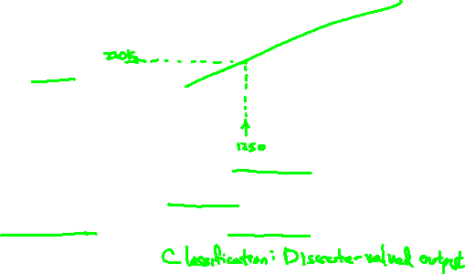
Housing Prices
(Portland, OR)
Price
(in 1000s of dollars)
Size (feet²)
Supervised Learning
Given the “right answer” for each example in the data.
Regression Problem
Predict real-valued output

Slide 32
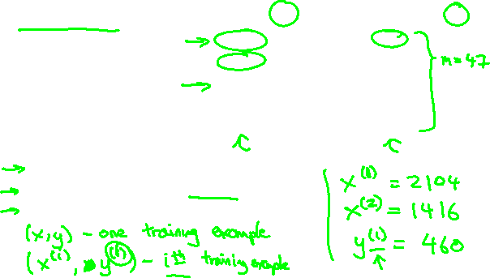
Training set of
housing prices
(Portland, OR)
Size in feet² (x) | Price ($) in 1000's (y)
2104 | 460
1416 | 232
1534 | 315
852 | 178
… | …
Notation:
m = Number of training examples
x’s = “input” variable / features
y’s = “output” variable / “target” variable

Slide 33
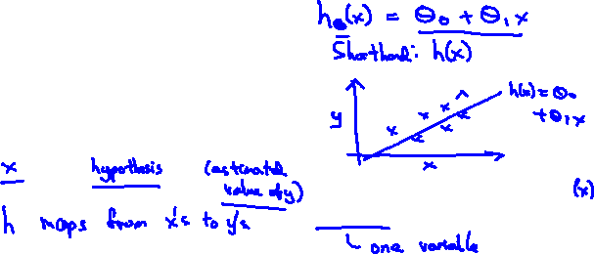
Training Set
How do we represent h ?
Learning Algorithm
Size of house
h
Estimated price
Linear regression with one variable.
Univariate linear regression.

Slide 34
Cost function
Linear regression with one variable
Machine Learning

Slide 35

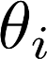
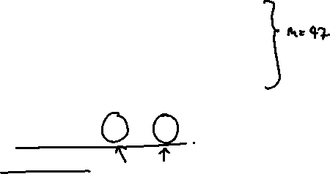
Training Set
Size in feet² (x) | Price ($) in 1000's (y)
2104 | 460
1416 | 232
1534 | 315
852 | 178
… | …
Hypothesis:
‘s: Parameters
How to choose ‘s ?

Slide 36
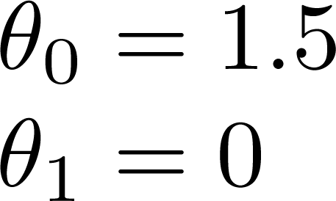
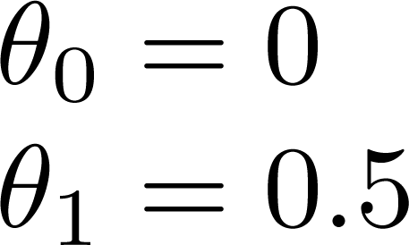
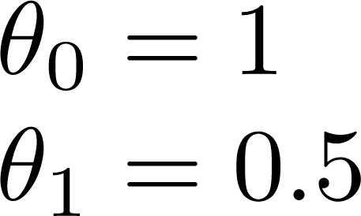
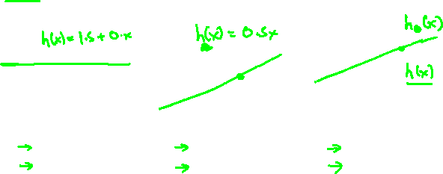

Slide 37
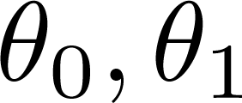
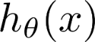

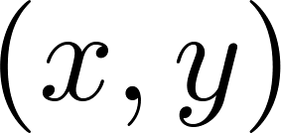
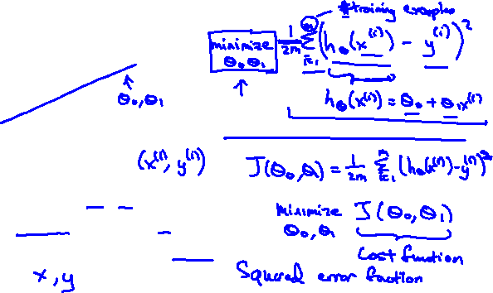
y
x
Idea: Choose so that is close to for our training examples

Slide 38
Cost function intuition I
Linear regression with one variable
Machine Learning

Slide 39
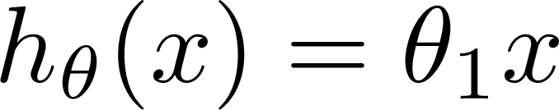

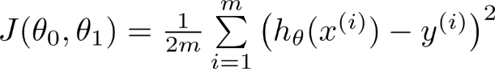
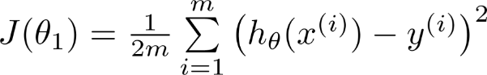
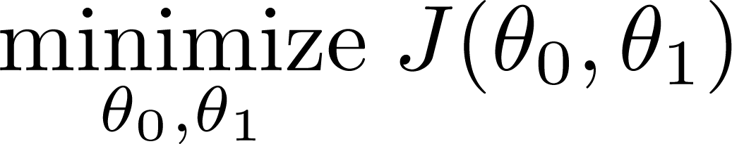
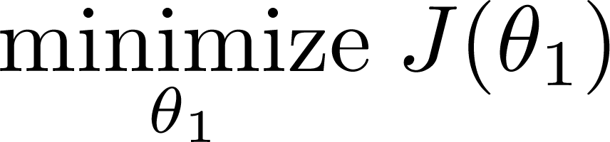
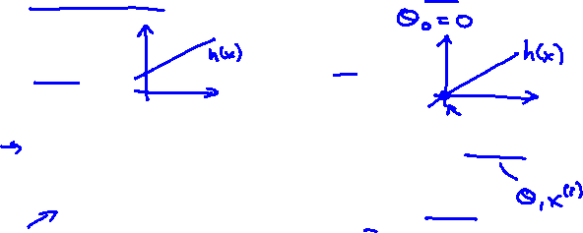
Simplified
Hypothesis:
Parameters:
Cost Function:
Goal:

Slide 40
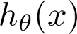
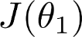

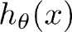
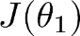
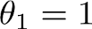
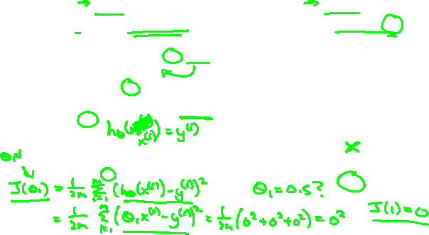
(for fixed , this is a function of x)
(function of the parameter )
y
x

Slide 41
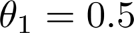
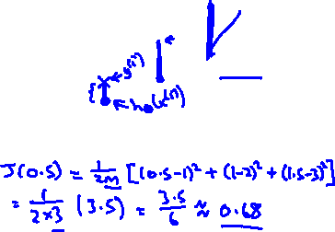
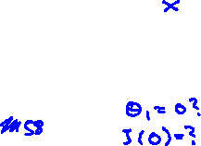
(for fixed , this is a function of x)
(function of the parameter )
y
x

Slide 42
Cost function intuition II
Linear regression with one variable
Machine Learning

Slide 43
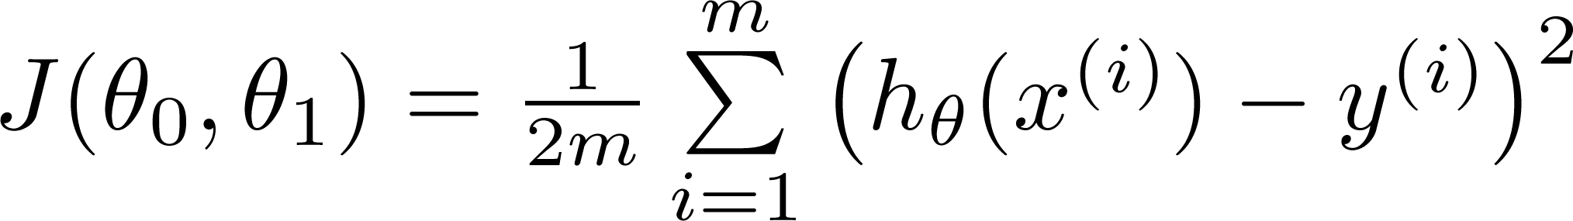
Hypothesis:
Parameters:
Cost Function:
Goal:

Slide 44
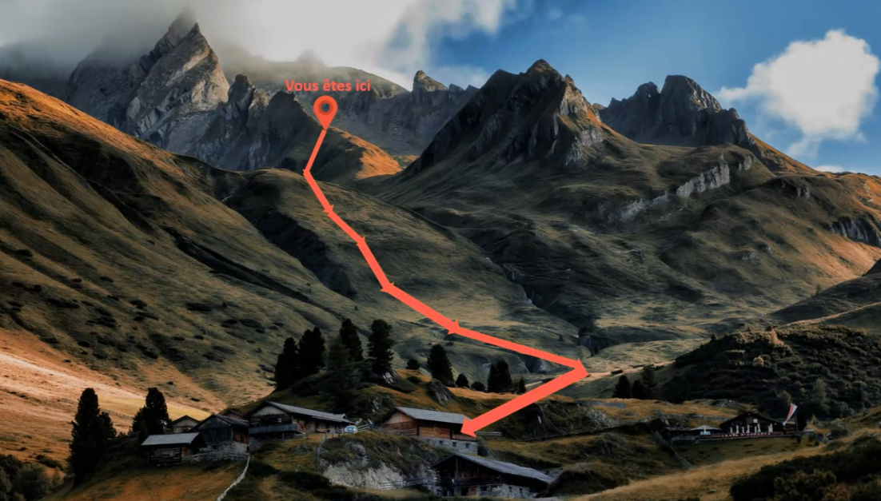
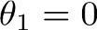
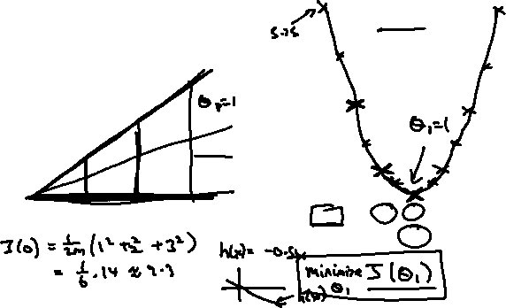
(for fixed , this is a function of x)
(function of the parameter )
y
x

Slide 45
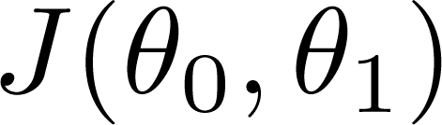
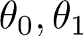
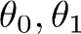
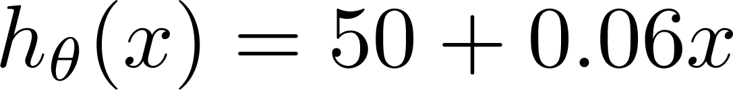
(for fixed , this is a function of x)
(function of the parameters )
Price ($)
in 1000’s
Size in feet² (x)

Slide 46
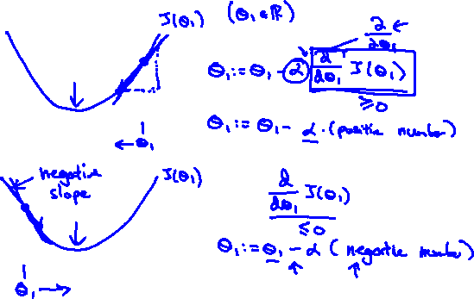

Slide 47
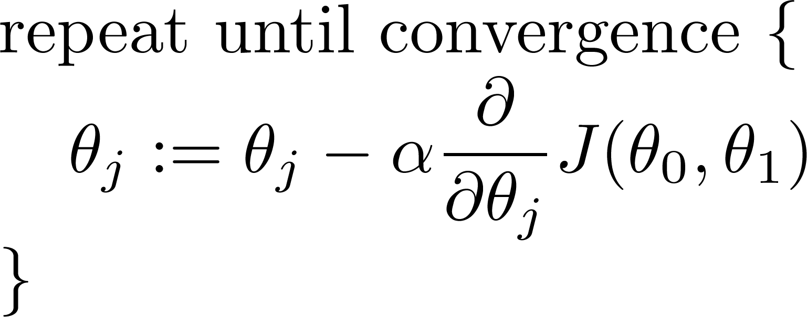
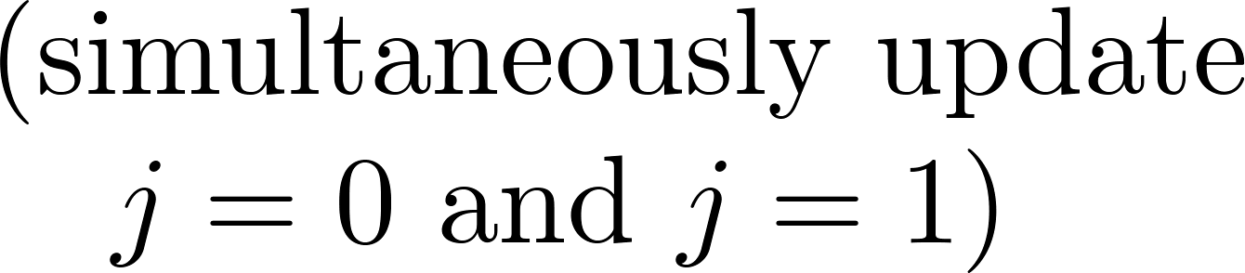

Gradient descent algorithm

Slide 48




Slide 49



(for fixed , this is a function of x)
(function of the parameters )

Slide 50



(for fixed , this is a function of x)
(function of the parameters )

Slide 51



(for fixed , this is a function of x)
(function of the parameters )

Slide 52



(for fixed , this is a function of x)
(function of the parameters )

Slide 53
Gradient descent
Linear regression with one variable
Machine Learning

Slide 54


Have some function
Want
Outline:
Start with some
Keep changing to reduce until we hopefully end up at a minimum

Slide 55


J(θ₀,θ₁)
θ₁
θ₀

Slide 56

J(θ₀,θ₁)
θ₁
θ₀

Slide 57





Gradient descent algorithm
Correct: Simultaneous update
Incorrect:

Slide 58
Gradient descent intuition
Linear regression with one variable
Machine Learning

Slide 59


If α is too small, gradient descent can be slow.
If α is too large, gradient descent can overshoot the minimum. It may fail to converge, or even diverge.

Slide 60


at local optima
Current value of

Slide 61

Gradient descent can converge to a local minimum, even with the learning rate α fixed.
As we approach a local minimum, gradient descent will automatically take smaller steps. So, no need to decrease α over time.

Slide 62
Gradient descent for linear regression
Linear regression with one variable
Machine Learning

Slide 63


Gradient descent algorithm
Linear Regression Model

Slide 64





Slide 65



Gradient descent algorithm
update
and
simultaneously

Slide 66
Simulate human intelligence
Why we need Machine Learning?
Automation
Help humans with informed decision making
Solve multidimensional problems
Predict future outcome based on historical observations
49

Slide 67
Finance
Marketing
Information Technology Cyber Security
Application Areas
Agriculture
Government
Automobile
Manufacturing Retail Entertainment
…
Everywhere!
53

